Slide 1






BCP Critical Application Analysis
Doc Ref: T320-RFP
A RGP Proposal for BOC International
8-Jun-2015

Slide 2
TABLE OF CONTENTS
SECTION | PAGE
RGP Overview | 3
Our Capabilities in Business Continuity | 8
Our Understanding of BOCI’s Objectives | 14
Project Approach | 17
Proposed Team Structure | 22
Project Schedule | 31
Conclusions | 33
Q & A | 35
Appendix A – Consultant Profiles | 37
Appendix B – RGP’s Project & Change Management Framework | 41

Slide 3
RGP Overview

Slide 4

RGP OVERVIEW
WHO WE ARE |  | GLOBAL REACH
WHAT WE DELIVER |  | OUR CLIENTS
A leading innovator in professional services:
Founded in 1996
Big Four heritage
NASDAQ listed (RECN)
13
$567MM | REVENUE IN FY 2014
3,100 | PROFESSIONALS WORLDWIDE
70+ | OFFICES GLOBALLY
100% | TOP 50 CLIENTS RETAINED YEAR OVER YEAR
RECOGNIZED | AS ONE OF THE 100 MOST TRUSTWORTHY COMPANIES BY FORBES.COM
47
OFFICES SUPPORTING EUROPE
12
OFFICES SUPPORTING THE AMERICAS
OFFICES SUPPORTING ASIA PACIFIC
People. Experienced Consultants with industry, commercial, functional and leadership experience; with an emphasis on execution and optimization.
Approach. Tailored and collaborative, resulting in knowledge transfer and sustained transformation without long-term reliance on external consultants.
Support. Project oversight and subject matter expertise provided by local Client Service Teams and global Practice Leaders on an unbilled basis.
Scale. Financial stability, global reach, cross-functional/enterprise-wide capabilities.
Cost. Reasonable hourly rates and variable cost engagement model. Administrative fees are never billed.
Value. A value proposition that far outdistances any competing offer.
85% | OF THE FORTUNE 1000 COMMERCIAL BANKS
75% | OF THE FORTUNE 1000 FINANCIAL DATA SERVICES COMPANIES
4 of 5 Top | OF THE FORTUNE 500 SECURITIES FIRMS
87% | OF THE FORTUNE 100
“We are a leading innovator in the consulting space providing a high quality, cost effective alternative to traditional consulting firms.”
Intellectual capital on demand.
Peter Drucker on RGP’s Business Model in the Harvard Business Review
OUR VAULES TALENT  INTEGRITY  ENTHUSIASM  LOYALTY

Slide 5
ENTERPRISE-WIDE CAPABILITIES
Enterprise-Wide Initiatives
Business process re-engineering
Transformation programs
Mergers & acquisitions
Outsource transition
Shared services
Operational excellence
policyIQ® software
Pavisse™ software
Regulatory compliance
Sarbanes-Oxley
Program Management ▪ Project Management ▪ Change Management
Finance & Accounting
Financial reporting
Restatements
General accounting
Accounting standards
Financial planning & analysis
Finance transformation
Shared services
M&A integration
Carve-out financials
Controls remediation
Process optimization
Governance, Risk & Compliance
Internal & IT audit co-sourcing
Sarbanes-Oxley compliance
Performance & mock audits
Contract / counter party audits
Compliance audits
Corporate governance
Enterprise risk management
Fraud / forensic audits
Information Management
Business analysis & integration
Process improvement
Implementation
Stabilization & optimization
Quality Assurance
Data management
Report strategy & development
IT governance & security
Outsourcing strategy
IT strategic planning
Human Capital
Organizational development / design
Change management
HR transformations
Training & communications
Compensation & benefits redesign
HR system initiatives
HR restructuring
Talent management
Succession planning
HR compliance
Procurement & Supply Chain
Supply chain assessment
Strategic sourcing
Conflict Minerals compliance
Commodity management
Capital procurement
Inventory rationalization
Contract management
Logistics & warehousing
Vendor audit
Legal & Regulatory
Commercial transactions
Mergers, acquisitions & restructurings
Regulatory compliance
SEC filings & corporate governance
IP agreements
Litigation management & investigations
Employment/ Employee benefits
Legal operations optimization
Our wide array of expertise allows us to support both your functional and enterprise-wide initiatives.

Slide 6
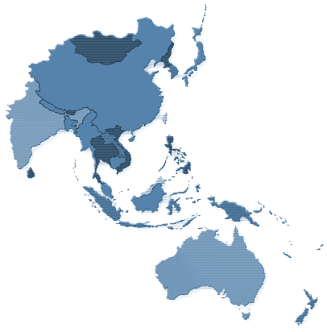


APAC SNAPSHOT
APAC Snapshot
500 projects; multiple pan-Asia
12 offices
300 professionals
Clients in 22 countries
Countries Served:
Australia
Cambodia
China
India
Indonesia
Japan
Korea
Malaysia
Industries Served:
Automotive
Energy
Financial Services
Hospitality/Gaming
Mongolia
Japan
South Korea
Resources Global Office
Additional locations where Resources Global has delivered projects
Mongolia
Nepal
New Zealand
Singapore
Sri Lanka
Taiwan
Thailand
The Philippines
Vietnam
Nepal
China
India
Taiwan
Thailand
The Philippines
Vietnam
Malaysia
Cambodia
Sri Lanka
Singapore
Indonesia
Australia
Insurance
Manufacturing
Mining
Pharmaceutical
Technology
Real Estate
Retail/FMCG
Safety
Telecommunications
New Zealand

Slide 7

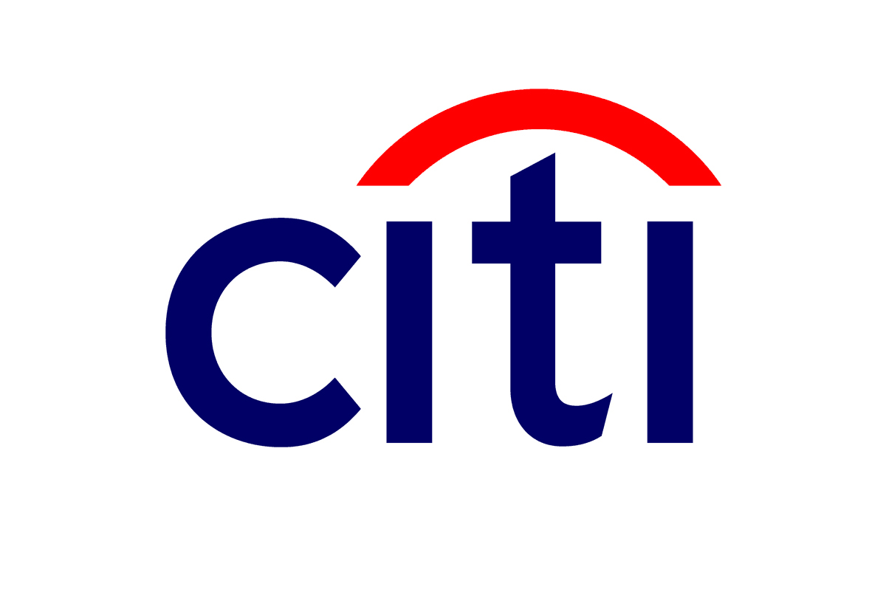






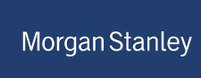












RGP HONG KONG
Established since 2000
Has 70+ Consultants average 18 years of experience with Big4 / MNC background
Professional expertise in:
Finance & Accounting
Information Management
Risk & Compliance
Clients we work with in Hong Kong

Slide 8
Our Capabilities in Business Continuity

Slide 9
CASE STUDY
Engagement Example (1)
CLIENT | Bank of China International
INTIATIVE | Business Continuity Planning (BCP) Assessment
CHALLENGE | BOCI IT wanted to ensure it had the capability to recover sustain business operations against disruptive events.
HOW WE HELPED | Our BCP consultant assisted the CIO, conducted meetings with IT & business, and developed a Strategic Proposal of a High Availability IT Infrastructure For Business Continuity Planning. Benchmarked with other well-known banking institutions, we have developed the executive summary report that aimed to raise organization’s awareness on recovery capabilities. Our consultant also developed the budget planning with implementation roadmap for BOCI IT.

Slide 10
CASE STUDY
Engagement Example (2)
CLIENT | A US-based Asset Management Firm
INTIATIVE | Business Continuity Plan Design and Development
CHALLENGE | The client initiated a project to develop a Business Continuity plan for their offices in Chicago, New York and the US Virgin Islands. The company wanted to ensure a plan was in place to keep the business functioning in the event of a major negative event. A BCP would also maintain the confidence of their investors and customers. The client engaged RGP to assess the disaster threats, determine areas of greatest business impact from an interruption, and develop recovery strategies.
HOW WE HELPED | A Business Continuity Program was developed that aligned with the company's IT disaster recovery plans and provided management with a process to react to and recover from any business interruption. It also provided department mangers a plan to guide them in ensuring that the critical processes were operational from their department for the recovery times required by the company.

Slide 11
CASE STUDY
Engagement Example (3)
CLIENT | A Large Financial Services Corporation
INTIATIVE | Disruptive Impact Analysis
CHALLENGE | This corporation determined that it had material weaknesses in its ability to recover from a major service disruption, both in its ability to recover systems and business processes. The corporation had offices in multiple locations in the US, including one in a flood zone and another in a seismic area.
HOW WE HELPED | We developed and implemented a complete business continuity and disaster recovery plan that included: Organizing business leaders, subject matter experts and IT managers into a cohesive steering committee to drive the analysis, implementation and testing. Completing documentation of standard business processes, including process flows, dependencies, system interaction, physical locations, and personnel responsibilities. Conducting complete business impact analysis based on scenarios of varying severity including seismic events. Developing and implementing IT Disaster Recovery plans, including building out and migrating to a new production data center and implementing full failover of critical applications to meet required service levels. Defining complete business continuity plans, covering personnel; functions, responsibilities, communications, critical service providers, and IT support groups and audit requirements. Successfully conducting multiple tests including full business continuity covering extended service disruption, fallback and regulatory compliance.

Slide 12
CASE STUDY
Engagement Example (4)
CLIENT | Health care services provider
INTIATIVE | Disaster Recovery Improvement
CHALLENGE | The company needed to identify opportunities to improve their Disaster Recovery and Business Continuity Plan to ensure their continued operation in the event of nearly any continuity risk.
HOW WE HELPED | Our Consultants evaluated the existing business continuity plan and the results of recent “table top” tests. They conducted extensive interviews with the management of all operational areas to identify several new areas where significant risk still existed. The team documented all risks and the current plan’s ability to address them. The team recommended a number of simple methods to ensure continuous product supply and customer support for months in the event of nearly any catastrophic incident.

Slide 13
CASE STUDY
Engagement Example (5)
CLIENT | Leading provider of integrated, end-to-end wireless solutions – from business and technology strategy to engineering services
INTIATIVE | Global BCP and DR Development
CHALLENGE | With 13 offices in 10 countries, the company needed to create a sound Disaster Recovery and Business Continuity Plan for all global operations.
HOW WE HELPED | Our team of professionals evaluated all office locations and distributed data centers to formulate advanced recovery plans. Our Consultants assisted in developing a redundant global structure that allowed the company to react with parallel operations in the event of failure at any location. Internal teams were trained in new procedures that would facilitate rapid and efficient recovery.

Slide 14
Our Understanding of BOCI’s Objectives

Slide 15
OUR UNDERSTANDING
It is our understanding that BOCI’s IT Division is seeking to engage external consultants to undertake an analysis of its services, processes and tools, and provide recommendations to improve its current Business Continuity Planning and Disaster Recovery capabilities:
Improved Business Impact Analysis (BIA)
In-depth Technical Dependency Analysis (TDA)
Efficient and Effective Disaster Recovery (DR)
Recommendations, Solutions, Future Action and Resources Plan

Slide 16
OUR APPROACH
Our project approach will be tailored to meet BOCI’s specific objectives and operating preferences. We will leverage our extensive expertise and experience with similar initiatives, and propose to execute this initiative in four steps:
Business Process Analysis
Technical Dependency Analysis
Gap Analysis
Implementation Roadmap
Step 1
Business Process Analysis
Step2
Technical Dependency Analysis
Step 3
Gap Analysis
Step 4
Implementation Roadmap
Project & Change Management
Management presentation or major review points

Slide 17
Project Approach

Slide 18
PROJECT APPROACH
Step 1
Business Process Analysis
Step2
Technical Dependency Analysis
Step 3
Gap Analysis
Step 4
Implementation Roadmap
Step 1 - Business Process Analysis (BPA)
PURPOSE | To review the existing business continuity capability To identify and prioritize critical business processes To map resources required for each critical process To evaluate impacts of each critical process for determination of recovery strategy
KEY ACTVITIES | Perform high-level documentation review to assess sufficiency of existing plan Conduct interview with process owners to identify operational processes Identify critical processes through assessment of overall exposure to BOCI if normal processes could not be performed (e.g. customer impact, regulatory impact, etc.) Perform time-frame assessment of the critical processes Analyze inter-dependency of business processes and other key elements, especially technology, and map these key elements to each critical process
DELIVERABLES
Business Processes Analysis (BPA) Report – The BPA Report documents the impact analysis and details all the critical processes with relevant systems and the required recovery time objectives. This form the basis for development of business recovery strategy.
Identification of critical business processes
Financial and non-financial impact analysis
Dependencies of critical business processes
Timeliness of critical business processes
Identification of relevant systems by business owners

Slide 19
PROJECT APPROACH
Step 1
Business Process Analysis
Step2
Technical Dependency Analysis
Step 3
Gap Analysis
Step 4
Implementation Roadmap
Step 2 - Technical Dependency Analysis (TDA)
PURPOSE | To study and identify technical dependency on critical business applications and infrastructure To determine current recovery time of critical business applications and infrastructure To identify relationship between critical business processes and applications and infrastructure
KEY ACTVITIES | Study existing system documents of critical applications Interview with system owners of critical applications Study existing IT infrastructure configurations in BOCI Identify all critical third parties Compile dependency matrix on critical IT systems
DELIVERABLES
Technical Dependency Analysis (TDA) Report - The TDA Report shows the analysis results on technical dependency (both applications and infrastructure) of critical business processes in BOCI. This allows the correct calculation of the current recovery time and identifies the right technical components for improving the overall business recovery time.
List of Critical Business Processes
Related IT Systems
Analysis on IT systems
System Owners, Users and Processes
System Architecture
System Components
External Dependency
Current Recovery Procedure
Current Recovery Time
Technical Dependency Matrix

Slide 20
PROJECT APPROACH
Step 1
Business Process Analysis
Step2
Technical Dependency Analysis
Step 3
Gap Analysis
Step 4
Implementation Roadmap
Step 3 - Gap Analysis
PURPOSE | To identify gaps on business continuity plan between current and best practice on critical business processes To recommend technology solutions to remediate identified gaps To address the failover scenarios for various key infrastructure components for business application recovery
KEY ACTVITIES | Review and comment on BCP Plan, Drill Procedures, Failure Drill(s) Identify gaps in RTO/RPO, control weaknesses and single points of failure Identify gaps between recovery strategy and current standings Identify possible alternatives to close the gaps Propose action points to close the gaps
DELIVERABLES
Gap Analysis Report – Report details the gaps between the recovery strategy of BOCI and the findings in BPA, TDA and the existing recovery procedures associated with different failure scenarios. Based on the findings, possible alternatives to will be identified to close the gaps. Action plan with priority will be recommended.
Recovery objectives
Identification of Current Standings
Business Processes
Technology
Procedures
Identification of Gaps
Feasibility study of possible alternatives to close the gaps
Action Plan

Slide 21
PROJECT APPROACH
Step 1
Business Process Analysis
Step2
Technical Dependency Analysis
Step 3
Gap Analysis
Step 4
Implementation Roadmap
Step 4 - Implementation Roadmap (budget & Planning)
PURPOSE | To select and prioritize solutions in gap analysis report To formulate implementation roadmap for BCP improvements
KEY ACTVITIES | Identify and prioritize key improvement initiatives Identify technical solutions Collect price information from vendor/supplier Develop implementation plan
DELIVERABLES
Technical solution (budget & planning) - Based on the result of the Gap Analysis, technology improvement initiatives will be identified to close the gaps whenever possible. The document provides a summary of the technical solutions with priority, budget and timeline such that BOCI can use it as a blueprint for the BCP improvement initiatives for the next 1 to 3 years.
List of technical improvement initiatives
Prioritize the initiatives according to the
impact and criticism to business
Ballpark figures for the financial components of implementation
Implementation schedule

Slide 22
Proposed Team Structure

Slide 23
PROPOSED TEAM STRUCTURE
Project Assurance
Project Director
Steering Team
Project Manager/Lead Consultant
Project Delivery
Project Team
BCP Business Specialist
Technical Architect
Role | Responsibility
Project Manager / Lead Consultant | Project planning and Governance Lead to deliver the Gap Analysis Report
BCP Business Specialist | Identify and confirm BCP requirements with business divisions Lead to deliver Business Process Analysis Report
Technical Architect | Technical guru in IT business systems, interfaces and components Lead to deliver the Technical Dependency Analysis Report
Project Director | independent and objective oversight of future performance liaison with RGP’s Global Center or Expertise when needed

Slide 24
DELIVERY TEAM
Mr. Pak Lam LUK - Project Manager / Lead Consultant
Over 20 Years of Post-qualification IT Experience
9 Years of Experience as Head of IT for a European bank
Relevant Experience:
Led a cross functional and matrix team of internal resources and external vendors to implement the integration of IT Infrastructure
designed and implemented a new DR (disaster recovery) and WAR (work area recovery) sites for bank to support a 60 people emergency workgroup, develop the failover procedures and manage drill tests at least twice a year
Conducted a Business Impact Analysis (BIA) for business units of Global Markets, Trade Finance, Private Banking, as well as back office functions including Operations, Finance, Risk, Compliance and HR for a master Business Continuity Plan formation
Please refer to Appendix for Consultant profile

Slide 25
DELIVERY TEAM
Ms. Chui Wah CHOW – BCP Business Specialist
A Big4 trained qualified accountant with 20+ years of experience
Qualifications: ACCA, HKICPA
Formerly held Operations Risk and BCP Manager positions for two banks and a payment company
Relevant experience:
led a bank’s Operational Risk Management team to revamp the BCP framework, including BCP policy writing, redesigning BCP life cycle/templates and facilitating the creation of new BCP by different bank divisions. Managed the subsequent BCP life cycle to ensure an effective continuity of key services
For an Electronic Payment company refined the BCP for an authorized institution with over 13 million transactions daily. Performed overall review on BCP documentation, especially impact analysis and recovery time objectives to improve overall quality of continuity plan for regulator's review. Planned the annual BCP and lined up different business units on maintenance of BCP and performance of drill test to ensure sustainability of the plan.
Please refer to Appendix for Consultant profile

Slide 26
DELIVERY TEAM
Mr. Jimmy TSE – Technical Architect
15 years of IT experience with a system development consulting background
Qualifications: PMP, MCP, Certified J2EE & J2SE, Six Sigma Greenbelt
leading role in System Development Life Cycle (SDLC);
Relevant Experience
Enterprise application experience especially in Banking application dependency checking, Application Resilience Planning; managed development team for .NET/Java/Oracle technologies or related technologies
Conducted application security and risk assessment. Recommended solutions, like application firewall, reverse proxy, data encryption, data manipulation and access separation to eliminate DOS, Log forging, SQL injection threats
Re-engineered client’s IT architecture from systems in silo into systems over an enterprise application backbone with web services and message queue over services bus consolidated into services components
Please refer to Appendix for Consultant profile

Slide 27
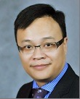
PROJECT ASSURANCE
Mr. Pasquale KWAN – Project Director
Previously the Director of Information Management practice of RGP Hong Kong, Pasquale has over 20 years in Information Technology in several capacities, including Program and Project Management, PMO development, Enterprise Service Delivery.
Held various Senior IT roles in large Multinationals, Pasquale had also spent two years in Europe, where he served as an independent IT/Management consultant for I.C.P.O. INTERPOL, the International Criminal Police Organization, headquartered in France.
Pasquale holds a Bachelor of Computer Science degree from University of Manitoba, Canada. He is a CISA, CRISC, PRINCE2 Practitioner and certified for ITIL as well as Six Sigma.

Slide 28
Project Schedule

Slide 29
PROJECT SCHEDULE
Jun-2015
Jul-2015
Aug-2015
Sep-2015
wk3
wk4
wk5
wk1
wk2
wk3
wk4
wk1
wk2
wk3
wk4
wk5
wk1
wk2
wk3
wk4
Project kick-off
Business Process Analysis
Technical Dependency Analysis
Gap Analysis
Implementation Roadmap
Propose to complete project in 16 weeks timeframe
Estimated hours for:
Project Manager 624 Hours (8 hours/day basis)
BCP Business Specialist 624 Hours (8 hours/day basis)
Technical Architect 624 Hours (8 hours/day basis)
Project Director 64 Hours (4 hours/week)
The total hours presented are ceiling hours; Consultant fee is based on Consultants’ actual billing hours that would not exceed this ceiling.

Slide 30
Conclusions

Slide 31
RGP’S CAPABILITIES
Disaster Recovery and Business Continuity Experience. RGP has assisted a wide array of clients with disaster recovery roadmap development, including the development, assessment, and optimization of business continuity plans (“BCPs”) and review of recovery capabilities of key applications and required business functions and processes.
Our Approach and Methodology tailored to BOCI specific needs. Our expertise lie not in implementing a single pre-determined formula, but in collaborating with BOCI to truly understand the needs and ensure we reach alignment on the identification of needs and approach for successfully meeting them together.
Unbiased Opinion. RGP is hardware and software agnostic – we are unbiased and objective when evaluating a client’s needs in relation to a system’s strength.
Change Management. Engraved as part of our overall project management capabilities, change management is a key aspect of our deliverables in which our Consultants are engaged in on-going stakeholder communication, help design and execute training and communication plans, and enable changes to be sustainable within the organization.
RGP Consultants and Client Service Team. Our Information Management practice is comprised primarily of IT and business professionals that have both technical and functional skills. Our BOCI Client Service representative remains committed throughout the engagement at no additional cost.

Slide 32
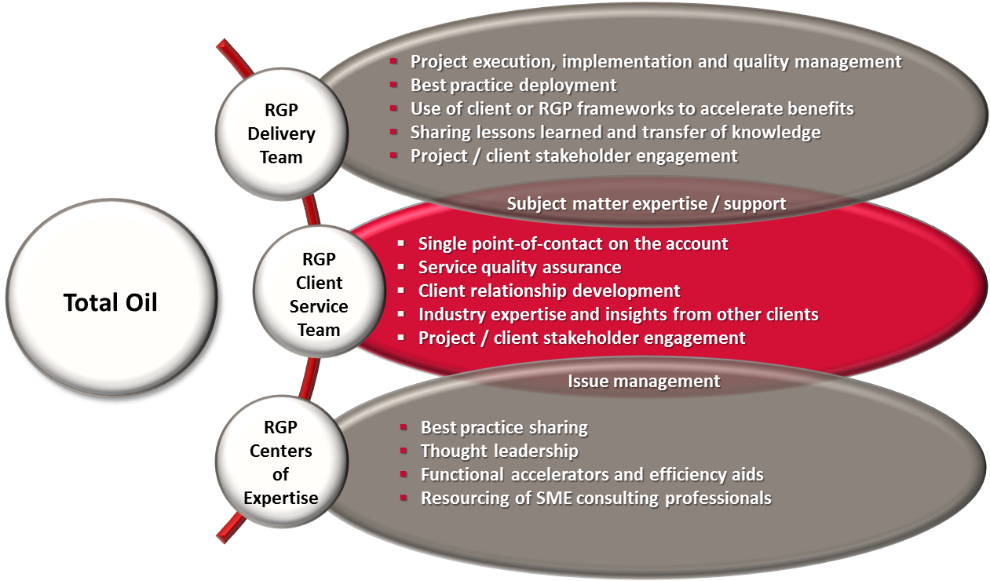
ENGAGEMENT MANAGEMENT OVERVIEW
All BOCI engagements will be executed under the management and support of a dedicated Engagement Team. The RGP Engagement Team is comprised of our Client Service Team and our Delivery Team, supported by our Centers of Expertise.
BOCI

Slide 33
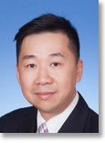

CLIENT SERVICE TEAM
AARON LEE – DIRECTOR INFORMATION MANAGEMENT, HONG KONG
Hong Kong
Aaron has more than 18 years of experience in IT, specializing in managing consulting services and enterprise system solutions implementation. He came to RGP from Atos Hong Kong where he was most recently the General Manager of Consulting and System Integration, after heading up Atos' Technical Consulting for a couple of years. Before Atos, Aaron ran consulting services for Fusion System, served as Technology Specialist Lead at Microsoft Hong Kong, and served as a Senior Consultant at Sybase. Aaron holds a Bachelor's degree with Honors in Information Systems from Staffordshire University (UK). Aaron's domain expertise includes business process re-engineering, IT strategic planning and enterprise solution implementation. He is also a pioneer in exploring e-business and e-government solutions, fostering strategic alliances with technology vendors throughout Asia Pacific. Aaron will be the central point of contact and service for BOCI, responsible for monitoring the progress of the project and Consultant performance.
ELAINE CHEUNG – DIRECTOR FINANCE & ACCOUNTING / RISK & COMPLIANCES
Hong Kong
Elaine is a qualified accountant with professional and commercial experience in both Hong Kong and Australia. She came to RGP from Ernst & Young where she spent almost 5 years in her last position as Senior Manager in Transactions Advisory Services, responsible for insolvency, restructuring, forensic investigation and corporate finance initiatives. Prior to E&Y, Elaine had worked for several professional and corporate advisory services firms on a variety of analytical reviews on financial statements, strategic diagnostic reviews, insolvent administrations, forensic investigations and corporate restructuring. Elaine holds a Bachelor degree in Economics (majoring in Accounting & Economics) from the University of New South Wales, Australia. She is also a qualified CPA, Insolvency Practitioner in Australia and is a holder of Specialist Designation in Restructuring & Insolvency.

Slide 34
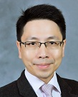
CLIENT SERVICE TEAM
SIMON KONG – MANAGING DIRECTOR, HONG KONG
Hong Kong
Simon has over 18 years of Information Management experience across industries and has led multiple consulting projects on business process transformation, shared service / BPO assessment and transition, and ERP systems implementation for RGP's clients since he joined the company in 2007. Prior to joining RGP, Simon was a Managed Services Account Executive with Computer Sciences Corporation (CSC) where he was responsible for managing regional accounts including client relationship and P&L, and leading a team of Project Managers and IT professionals to deliver professional services for global clients. Prior to CSC, Simon held a number of IT management positions at Sun Microsystems Inc. where he ran various global and regional projects on process improvement, organization transformation, and business solution implementation both within IT and across business units.

Slide 35
Q & A

Slide 36
THANK YOU
Aaron Lee
Director, Information Management Hong Kong
aaron.lee@rgp.com
+ 852 2248 2299
Resources Global Professionals
www.rgp.com
Hong Kong
Unit 2001, Ruttonjee House, 3011 Duddell Street, Central, HK
Shanghai
Room 2705-06, Lippo Plaza, 222 Huaihai Middle Road,
Shanghai 200021 PRC.
Beijing
Unit 815A, Tower1, Sun Dong An Plaza, 138 Wangfujing Dajie, Dongcheng District, Beijing 100006 PRC.
Singapore
8 Shenton Way #46-02, Singapore 068811

Slide 37
Appendix A – Consultant Profiles

Slide 38

Project Manager / Lead Consultant – Pak Lam LUK
Industry Experience
Professional Services
Retail/Investment Banking
Market Data Services
System Integrator
Functional Experience
IT Services Delivery
Project Management
Change Management
Vendor management
Application Deployment
Problem & Incident Management
Stakeholder Management
Technology Risk Assessment
Business Continuity Management
Budget control & Monitoring
IT Procurement
Systems Experience
MS Office Suite, MS Project, MS Exchange, Lotus Notes, T24, Sophis, 4Sight, Murex, Horizon, ORC, SmartStream, Concur, SWIFT
Methodologies
Prince2
ITIL
Education
The Hong Kong Polytechnic University, Higher Diploma in Electronic Engineering
Languages
English, Cantonese, Putonghua
Hong Kong Office
852 2878-7711
Relevant Business Experience:
Participative IT professional; results focused, customer oriented and practical. Progressive leadership experiences have created a passion for service objectives via a combination of high quality IT services, cost effective operating model, renewed technology directions, and initiatives for continuous improvement.
Led a cross functional and matrix team of internal resources and external vendors to implement the integration of IT Infrastructure aligned with the merge between Fortis Bank Nederland and ABN AMRO Bank in Hong Kong, with associated IT operation processes re-engineering, organizational change and business readiness to support the “working as one bank” initiative.
Consolidated and provided all necessary information and materials to Head Office in the TRAP (Technology Risk Assessment Program) process which is under the governance of ABN AMRO Information Management Policy and is a mandatory process for certifying any new setup in ABN AMRO offices.
Designed and implemented a new DR (disaster recovery) and WAR (work area recovery) sites for ABN AMRO Bank in 2010 to support a 60 people emergency workgroup, develop the failover procedures and manage drill tests at least twice a year.
Coordinated and implemented the relocation of the DR (disaster recovery) and WAR (work area recovery) sites from Somerset House to Cavendish center in 2013.
Conducted a BIA (Business Impact Analysis) for business units (Global Markets, Trade Finance, Private Banking) and back office functions (Operations, Finance, Risk, Compliance and HR) in order to formulate a master Business Continuity Plan.
Conducted Annual Supervisory Control Self assessment on Technology Risk Management, Business Continuity Management and E-Banking, worked closely with Audit and Compliance to identify outstanding issues and initiated technology changes to close the gaps.
Delivered and implemented a secure remote access solution to provide the capability of work from home and/or getting access to business information outside the office premises for process improvement and business continuity initiatives.
Revamped the IT infrastructure for Fortis Bank Nederland (after being carved out from Fortis Group), led the IT procurement process and select the most cost effective solution for setting up the new environment for supporting 150 people in 3 business units (Global Markets, Trade Finance and Fund Services).
Relevant Career Experience:
2005–2014 ABN AMRO Bank N.V.
Head of IT
1990–2005 Belgian Bank (acquired by ICBC Asia)
Senior Manager, Network Control & Office Automation
1988–1989 Reuters South East Asia
Communications Project Manager
1986–1988 Datacraft H.K
Data Communication Engineer

Slide 39
BCP Business Specialist - Chui Wah CHOW ACCA, HKICPA
Industry Experience
Electronic Payments
Banking
Government Authority
Big 4
Functional Experience
Business Continuity Management
Operational Risk Monitoring & Management
Control Self-Assessment Management
Internal Control & Process Review
Systems Experience
MS Excel, Word, PowerPoint
Education
University of Manchester
- Master of Business
Administration
City University of Hong Kong
- Bachelor of Arts in
Accountancy
Languages
English, Cantonese, Mandarin
Hong Kong Office
852 2878-7711
Relevant Business Experience:
A Big4 trained qualified Accountant with over 20 years of experience various industries covering Banking, Electronic Payments, Government Regulatory Body and Big4.
Experienced in overseeing BCP management, including policy development and enhancement, templates creation and launch, regular plan review, drills, and backup systems.
Led the Operational Risk Management team to revamp the BCP framework for a bank, including BCP policy writing, redesigning BCP life cycle/templates and facilitating the creation of new BCP by different parties. Managed the subsequent BCP life cycle to ensure an effective continuity of key services.
For an Electronic Payment company refined the BCP for an authorized institution with over 13 million transactions daily. Performed overall review on BCP documentation, especially impact analysis and recovery time objectives to improve overall quality of continuity plan for regulator's review. Planned the annual BCP and lined up different business units on maintenance of BCP and performance of drill test to ensure sustainability of the plan.
Established framework for BCP arrangements during launch of new products/ services; this involved process review for inclusion of BCP arrangement evaluation in every new products launch to ensure critical services could be maintained during disaster with a balanced cost and benefit analysis.
Followed the BCP life cycle to maintain and review the BCP for multinational bank. Reviewed the call center arrangements to ensure seamless transition between shifting from production site to alternative site.
In depth knowledge in implementing and monitoring operational risk management framework, such as putting into practice of key risk indicators, launched regular self-assessments, advised on operational risk and internal control related issues upon new products/services launch and internal controls review.
Managed an Operational Risk Management System implementation experience and was involved in criteria confirmation, identification of customization needs, UAT, data verification and historical data treatment and user training.
Relevant Career Experience:
2011–2015 Octopus Cards Limited
Senior Manager – Systems & Testing Support 2014-2015
Senior Manager – Project Management 2011-2014
2010–2011 Bank of China (HK) Limited
Senior Operational Risk Manager
2009–2010 Fubon Bank (HK) Limited
Vice President, Operational Risk Management
2007–2008 HealthBaby Biotech (HK) Company Limited
Operating Director
1997–2007 DBS Bank (HK) Limited
Vice President
1994–1997 Hong Kong Monetary Authority
Officer
1992-1994 KPMG Peat Marwick
Accountant

Slide 40
Technical Architect – Jimmy TSE
Industry Experience
E-commerce / Business to Business
Telecommunications
Supply Chain
Tax Accounting
Functional Experience
Business Process Re-engineering
Process Improvement
Change Management
Project Management
PMO
Quality Management
Systems Experience
Windows Server, Virtualization, SharePoint, Cloud Technologies, SQL Server, Exchange Server, Security, Active Directory
Education
Informatics College - Advanced Diploma in Computer Studies
Professional Qualification
Six Sigma Green Belt
PMP
MCP
Certified J2EE Developer
Certified J2SE Developer
Languages
English, Cantonese, Mandarin
Hong Kong Office
852 2878-7711
Relevant Business Experience:
IT professional with a system development background; over nine years of experience in leading role in System Development Life Cycle (SDLC); strong enterprise application background especially in Banking application dependency checking, Application Resilience Planning; managed development team for .NET/Java/Oracle technologies or related projects; experienced in project planning and governance.
Setup and manage development team for .NET/Java/Oracle technology related projects; direct and lead teams to deliver projects; allocate resource efficiently to meet tight project schedule; monitor and control project progress; perform risk analysis and management throughout the project life cycle; communicate with key stakeholders to understand and manage their expectations.
Led a team of IT specialists to re-engineer client’s IT architecture from systems in silo into systems over an enterprise application backbone. Systems were integrated together by web services and message queue over services bus. Some key business logics were consolidated into services components and relocated into a services layer in the application backbone.
Led technical experts to conduct application security and risk assessment. Recommended solutions, like application firewall, reverse proxy, data encryption, data manipulation and access separation, etc. to improve the security by eliminate threats like DOS, Log forging, SQL injection, etc.
Led a team of functional subject matter experts and IT specialists to re-engineering processes in manufacturing plants. The processes include business continuity planning and disaster recovery plan
Identified and measured KPIs on software development life cycle in project delivery team. Improved delivery time and quality of software by re-engineered processes in the delivery cycle.
Facilitated and directed change management committee to analyze, select and prioritize change requests in operation systems of an ISP. Strengthen the process by implemented scoring approach on change prioritization and selection;
Led a team of subject matter experts and IT specialists to improve processes of a project management office with the support of project management methodology and software
Designed management processes, tools and systems, with accompanying training to improve performance and procedures for clients.
Relevant Career Experience:
2014 – 2015 SPRO Consulting Group Limited
Project Manager
2012 – 2013 WiderWorld Limited
Project Manager
2011 – 2012 Hutchison Telecom (Hong Kong) Limited
Assistant Project Manager
2009 – 2011 EPRO Technology Limited
Senior System Analyst
2007 – 2009 Noble Group
Business Analyst
2006 – 2007 Internet Gaming Entertainment
System Analyst
2005 – 2005 B.S.C. Group
Analyst Programmer

Slide 41
Appendix B – RGP’s Project & Change Management Framework

Slide 42
RGP’s Project Execution Framework: ARROwS
RGP’s ARROwS Project Management Framework illustrates our project philosophy. First and foremost, RGP’s Delivery Team will follow BOCI’s chosen standards and methodology.
discovery
deployment
ONGOING
assess
rationalize
realize
optimize
Describe current and alternative future states | Select alternative and plan the approach | Implement approach to reach desired new state | Operate and improve the new state
Clearly understand the current state Articulate potential future states and relative values | Select a preferred alternative Define approach to realize the desired new state | Deploy solution Ensure effective and complete knowledge transfer | Incorporate feedback for continuous improvement Monitor progress
pmo in-a-box toolkit
sustain - E³ change management
Refer to the following slides for additional information regarding RGP’s Change Management framework and PMO-in-a-Box Toolkit.

Slide 43
Approach to Change Management – E3
RGP monitors all performance, execution and end products with a client-centric and agile approach which encapsulates the entire project lifecycle. RGP’s E³ Change Management framework promotes continuous improvement as best practices are identified and strategic objectives are refined.
E
Engage
Ongoing Stakeholder communication to gain and maintain buy-in and support
3
Execute
Training and communication to ensure successful implementation of change
Identify stakeholders
Develop key messages
Define engagement plan
Develop communication
Assess stakeholder impacts
Develop and deliver training
Develop and roll out communication
Assess outcomes
Enable
Organizational analysis and modification to enable and sustain change
Clarify change objectives
Evaluate change readiness
Identify organizational modifications

Slide 44
RGP’s PMO-in-a-Box
RGP’s PMO-in-a-Box incorporates tools, templates, and best practices for processes and deliverables, as applicable, serving as an accelerator for project efforts.
PMO-IN-A-BOX TEMPLATES AND TOOLS
INITIATING | PLANNING | EXECUTING | CLOSING
Project/initiative charter Stakeholder register Stakeholder management strategy Business case Project success matrix Project stakeholder map Prioritization of deliverable/functionality based on key business objectives Requirements elicitation | Plans (scope, cost, requirements, quality, schedule, resources, improvements, progress, communication, risk and procurement) Risk assessment Project cost estimator Performance metrics inventory Project portfolio management Workflow deliverables Business readiness plan Project team roster Project organization chart RACI matrix | Project status report Project meeting agenda Project meeting notes Project issues register Project risks register Project action items register Project change request Project change requests register Risk evaluation matrix Project process health assessment Project performance measures roadmap | Project acceptance Post project review Lessons learned

